Slide 1
Advanced Data Planning Tool
Rajiv Ranjan
Technical Programme Officer
PARIS21

Slide 2
PARIS21
Outline
Development data planning
What is ADAPT?
Results

Slide 3
PARIS21

Slide 4
PARIS21
Global partnership fostering national statistical capacities
Coordinating and convening users and producers of development data
Strengthening statistical systems for better data
Promoting National Strategies of the Development of Statistics and increasing the availability, reliability, use and value of data
Fostering innovation
Identifying, sharing and promoting innovations and best practices in data production, collection and dissemination
Making the data count
Advocating for better use of statistics for better lives
Partnership in Statistics for Development in the 21st Century
http://www.paris21.org/

Slide 5
Development Data Planning

Slide 6
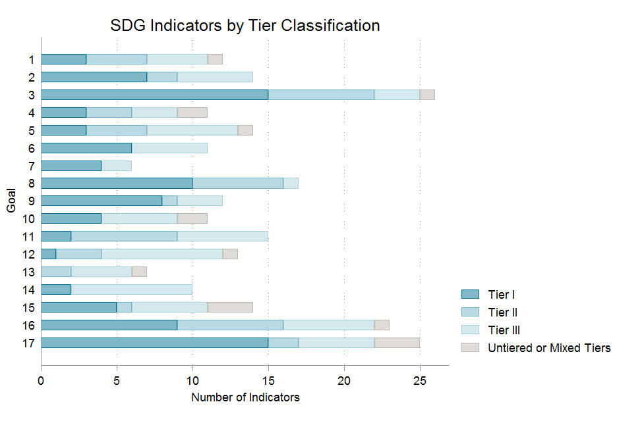
SDGs & data gaps
Only
42%!
http://www.cgdev.org/blog/sdg-indicators-serious-gaps-abound-data-availability
Notes:
Current situation: SDGs,

Slide 7
Country considerations
Data needs
Data gaps (Availability, disaggregation, frequency)
Requisite methodological harmony
Discrepancies between sources
Collaboration necessities
Institutional roles and responsibilities
Resource requirements
Budget and donor support
Monitoring obligations
Feedback loop
Global
National
Notes:
Why do planning for development data?

Slide 8
National Statistical System
NSS: Ensemble of organizations and units within the country that jointly collect, process and & disseminate official statistics on behalf of the Government
NSDS:
Framework for the programs, projects and activities of the National Statistical System (NSS)
Comprehensive strategy document, aimed at development of data and statistics in the national context
Brings together various stakeholders towards achieving the shared goal of better statistics
Provides strategic and coherent planning
Planning
Data supply
Data demand
Gap
National Strategy for the Development of Statistics (NSDS)

Slide 9
What is ADAPT?

Slide 10
Description
A web-based tool for planning data related activities in a National Statistical System
Bring together key sector planners with monitoring role in the SDGs or NSDS under one virtual space: National Monitoring Log Frame.
Use a cost data base to estimate cost of data collections
Provide clear output, including charts and financial tables to present to planners, partners and policy makers

Slide 11
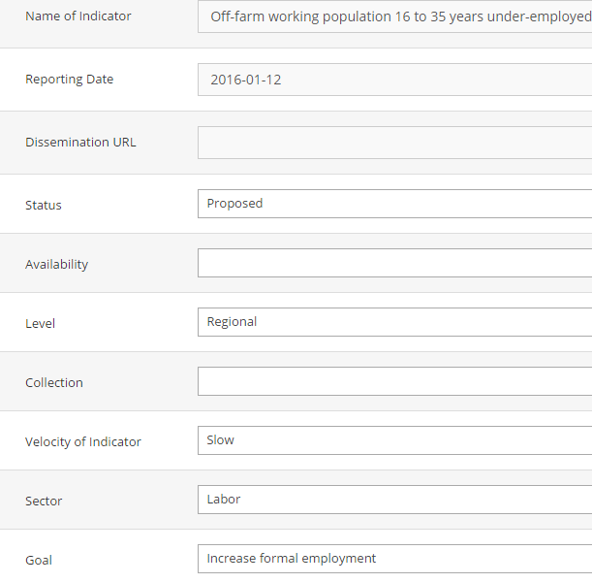
Consultations
Multiple monitoring frameworks in one place
Leverage technology to post indicators to a central database and assign for reviewing and approval across the National Statistical System
Associate planning metadata to the indicator
When will it be reported?
Where will it be disseminated?
What is the status?
Is the data currently available?
At what geo level is it representative?
Is it an international collection?
Is the indicator fast moving?
Who is the custodian of the data?
Who will compute the indicator?
What are the disaggregation variables?
Reference indicator collections and adopt into the National Framework
Key: Unique Indicator Identifiers (NSO)

Slide 12
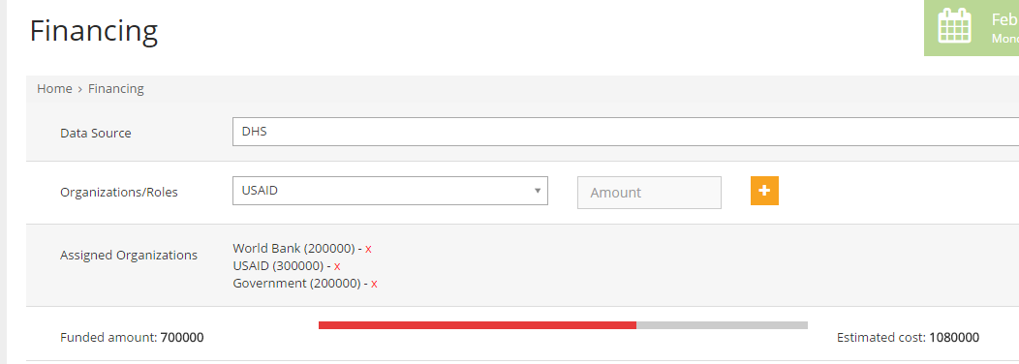
Costing
Three levels of cost management
Do quick estimates based on historical per household or per person (unit) cost of collections
Do more thorough estimations using cost of inputs
Full data collection budget using Generic Statistical Business Process Model
Attribute financing commitments
Capture unknown costs
International technical assistance
Sector administrative systems

Slide 13
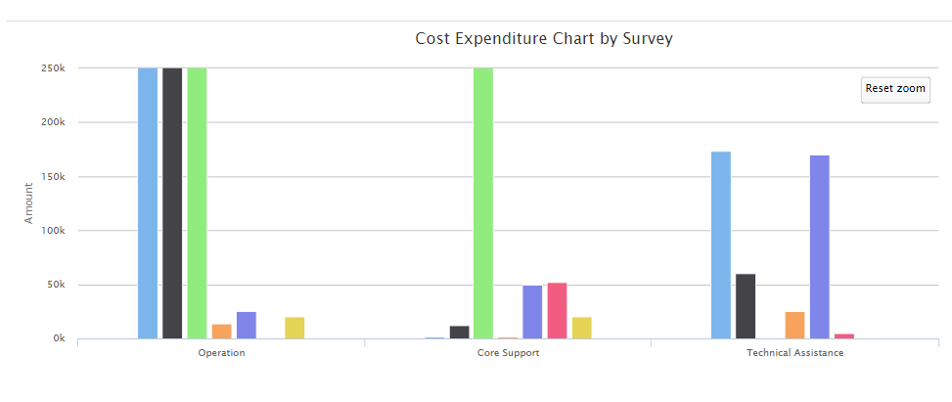
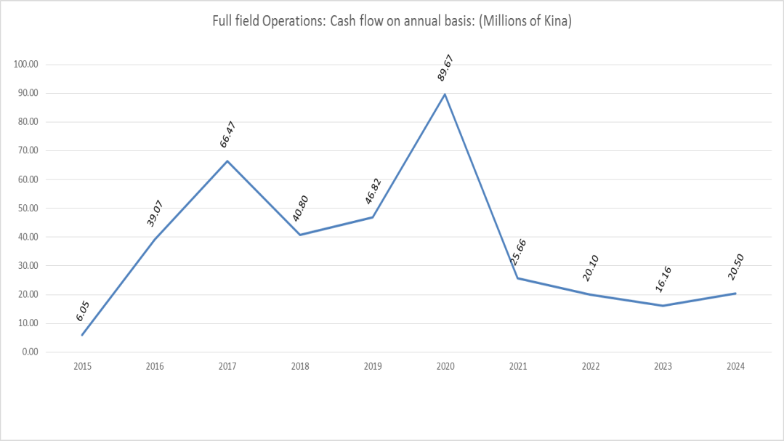
Charting
Visualization and sensitivity analysis
Visualize funding existing gaps
Production of useful planning charts such as cash flow statements etc.

Slide 14
Results

Slide 15
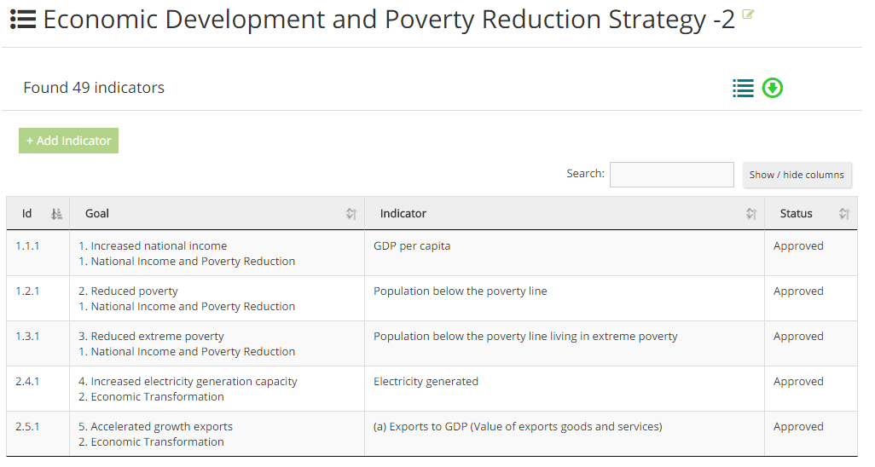
Benefits
Country specific development planning frameworks mapped to various other logframes and shared.
Data gaps identified and understood
Possible data sources identified and costed
Data collection activities scheduled
Required NSDS annexures produced
Resource requirement (funding) proposals ready
Monitoring of NSDS

Slide 16
Pilots

Slide 17
http://rw.adapt.paris21.org/
Countries
http://cm.adapt.paris21.org/
http://ph.adapt.paris21.org/
Rwanda
Cameroon
Philippines
Cambodia
Bolivia
http://kh.adapt.paris21.org/
http://bo.adapt.paris21.org/

Slide 18
Success doesn't just happen. Its planned for.
- Anonymous

Slide 19
Thank you!

