Slide 1
Data Revolution
& The Arab Region
Arab Forum on Building Statistical Capacity for Data Revolution
Doha, Qatar, 10-11 October 2016

Slide 2
Data Revolution & the Arab region
2030 Development Agenda
Broader than the Millennium agenda
Higher demand for statistical evidence
Comparable but with a local focus
Data Revolution
A wider scope of policy issues covered
Detailed breakdown
thematic
Geographic (sub-national data)
High frequency data

Slide 3
Data Revolution & the Arab region
Regional Challenges
3 of 22 Arab countries have a valid NSDS
– opportunity to reflect 2030 Agenda in NSDS
Limited availability of data
Significant variations in data (by source)
Coordination between various producers of data
Making statistics effective tool in policy making
Use of administrative registers and records
Data quality frameworks

Slide 4
Data Revolution & the Arab region
National Stategies for Development of Stat.
Challenges:
Only 3 of 22 Arab states have currently valid statistical strategies
15 Arab states have their statistical strategies expired
4 Arab states do not have a statistical strategy
Opportunities:
Reflecting Data Revolution and 2030 Agenda in NSDS
Comprehensive assessments of national statistical systems
Aligning NSDS with national development strategies

Slide 5
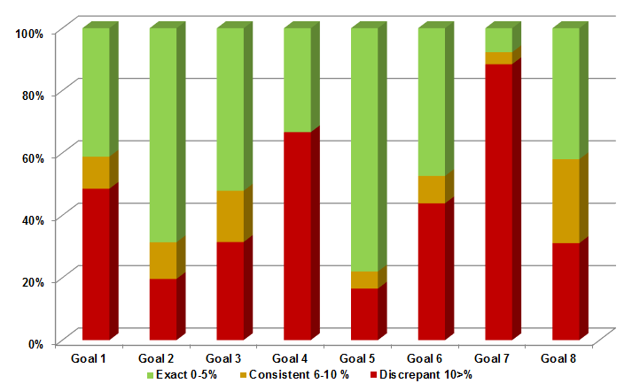
Data Revolution & the Arab region
MDGs – Data variations by goal

Slide 6
Data Revolution & the Arab region
SDG data availability in the Arab region
Average availability of data / per goal / per country:
No data 1-2 data points 3 and more data points

Slide 7
Data Revolution & the Arab region
SDG data availability in Arab countries
Number of countries with data availability per goal:
No data 1-2 data points 3 and more data points
0
16
21
17
1
13
8
6
1
3
20
9
14
0
0
2
1
0
16
8
0
1
1
14
1
13
0
6
7
3
5
1
22
15
14
5
7
1
1
9
15
8
0
0
5
4
7
21
21
8
3

Slide 8
Data Revolution & the Arab region
Building National Statistical Systems
Challenges:
Data producers working in isolation
Insufficient use of available data
Insufficient use of population registers, business registers, and other administrative sources
Opportunities:
Institutional setup of national statistical systems
Sharing statistical data and data sources
Creating Statistical Councils
Empowering National Statistical Offices with nation-wide coordination

Slide 9
Data Revolution & the Arab region
Principles for SDG data breakdown
income
sex
age
race
ethnicity
migratory status
disability
geographic location
or other characteristics, in accordance with the Fundamental Principles of Official Statistics
In addition: breakdown emanating from the text of the indicators.

Slide 10
Data Revolution & the Arab region
Principles for SDG data sourcing
Indicators should be standards based
Indicators should be nationally sourced
There should be a communication with member countries prior to data release
Reducing reporting burden – sharing data among UN agencies / regional agencies / …

Slide 11
Data Revolution & the Arab region
New themes for Arab statistics
Societal development and well being
Human rights
Governance

Slide 12
Data Revolution & the Arab region
Representing Arab region at the global level
National Statistical Offices in the driving role
Balanced regional representation
Observers:
Observer countries
Observer organizations
Civil society
Inter-Agency Expert Group on SDG Indicators
Algeria, Bahrain, Egypt
High Level Group on Partnership and Capactity Development
Palestine, Tunisia, Yemen

Slide 13
Data Revolution
& the Arab region

