Slide 1
How to capture the value from Big Data to address social questions?
Data-for-Good @
Keynote speech
Doha, October 2016

Slide 2
What is the context?

Slide 3
Born in Africa and leveraging a young and entrepreneurial approach
Clients across the world reaching over 400 million people
Trusted by 5 of the largest global telecom operators
Office or Presence
Commercial approach – We operate relations with 5 out of the top 10 telecom operators in the world through about 30 countries and develop global product portfolio in Big Data
Social approach – We work with the largest and most innovative donors in the world and have secured access to telecom data in 22 emerging countries, mostly in data-poor environments
… and the largest donors

Slide 4
The situation
Society doesn’t fully capture the benefits from the increasing availability of data and the gains of digitalization
The complication
Many countries face a tremendous and harmful lack of public data, while (i) large amount of data remain behind firewalls of private corporations, (ii) private sector lacks incentives to build the infrastructures required to fully leverage existing data, (iii) current approach focuses on use cases and does not prioritize key blocks to reach scale
A solution
Identify a disruptive approach to foster and accelerate developments leveraging the private sector and reach scale to primarily address social questions. Long term, we need to develop ecosystems of algorithms, data and technical skills

Slide 5
Innovate with data providers and co-create a global market for social products
Satellite Big Data
Support the work on Sustainable Development Goals in emerging countries
Telecom Big Data
Call Detail Records
Data / URL logs
Signaling data
Network counters
Call center data
Handsets data
Support the mobility and social inclusion strategy in Western Europe

Slide 6
The goal is to create tools but the value chain is complex
<
<
Training tools and capacity building within end-users
<
Data-for-Good@RIA has been developing tools across all levels
Visualization tools and integration / implementation within end-users systems
<
Advanced algorithms
<
Platform of aggregates and First layer of aggregations, including standard aggregations
<
Data platform, including connectors and data checkers to standardize formats and ensure data quality
<
<
Telecom data, including CDRs, recharges, mobile money logs, mobile internet logs, network data such as BTS and utilization of the network
Third parties data sources, including satellite data, public health data, survey data, national statistics

Slide 7
Smart cities – Urban planning and transportation
Public health
What can be done?
Poverty mapping
SDGs
Gender

Slide 8
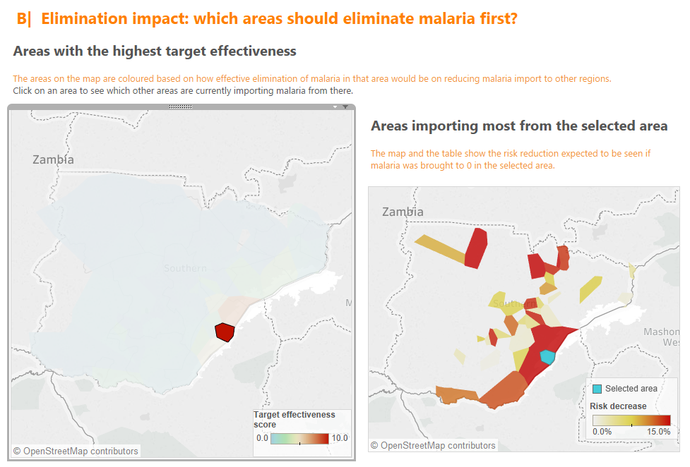
Public health – Prioritizing the work Example from Malaria

Slide 9
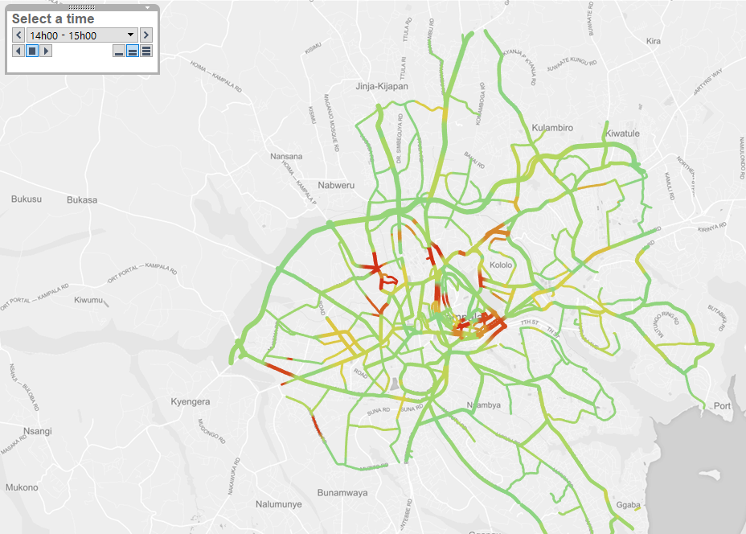
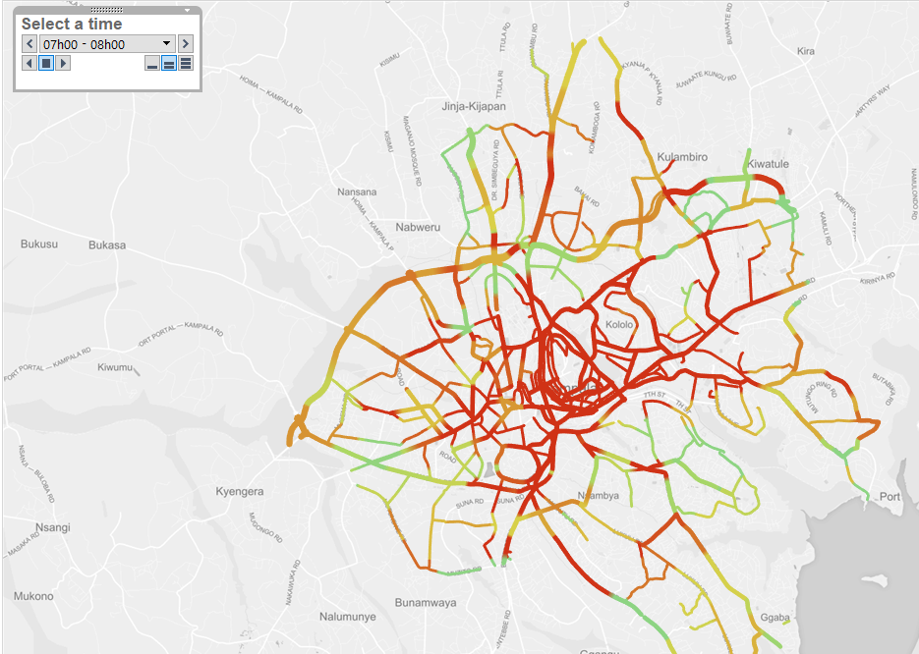
Mobility – Traffic flows

Slide 10
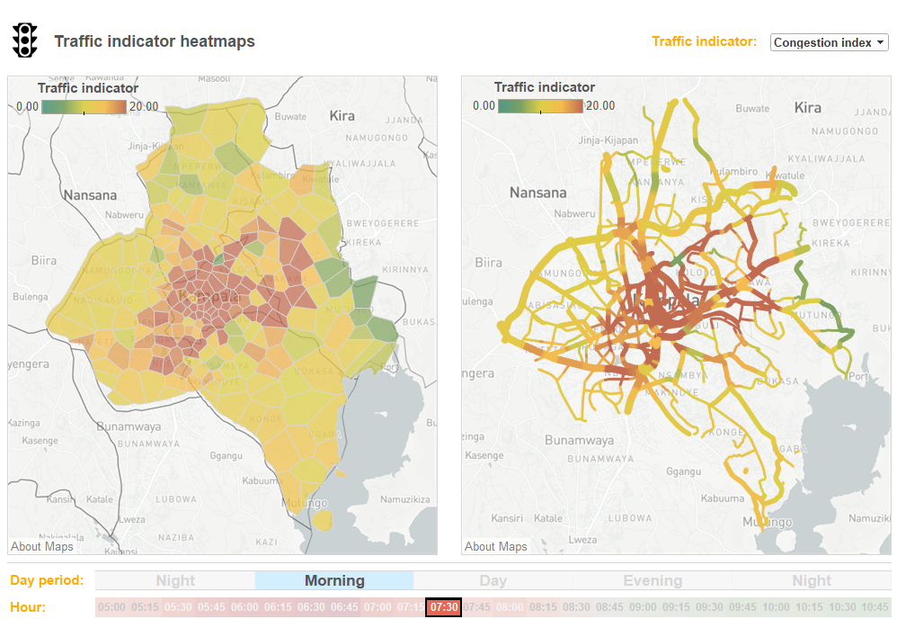
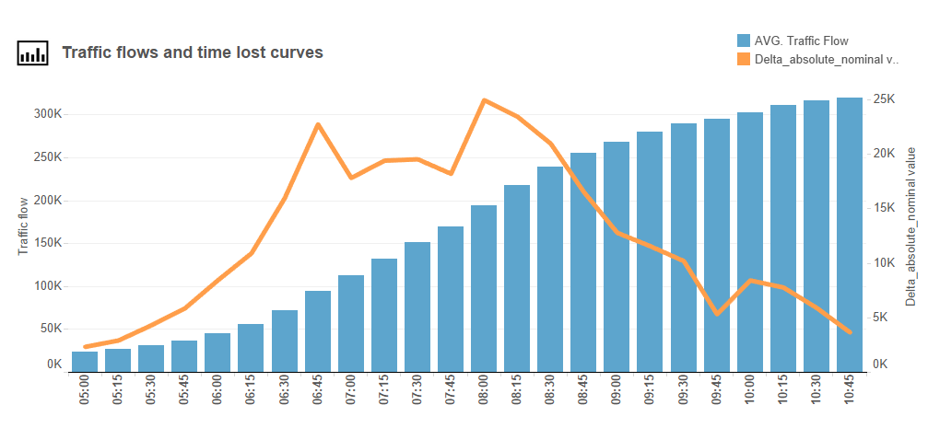
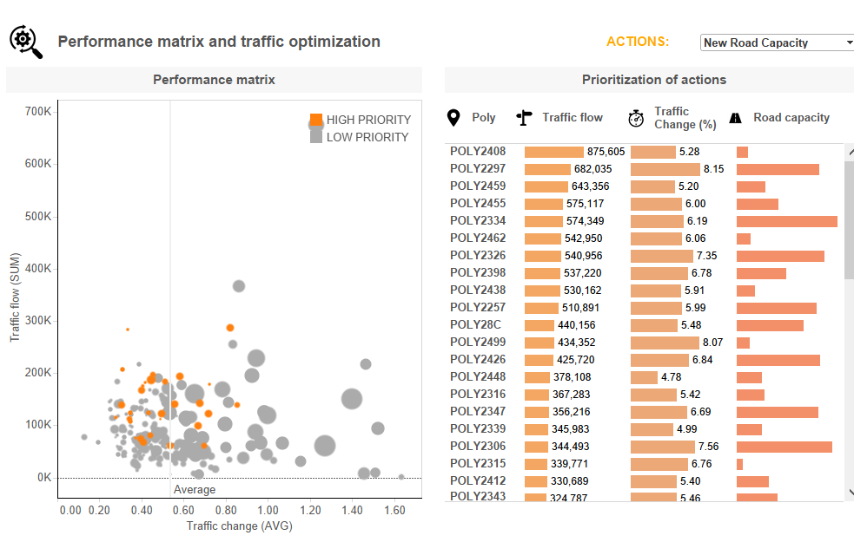
Mobility – Optimization of traffic

Slide 11
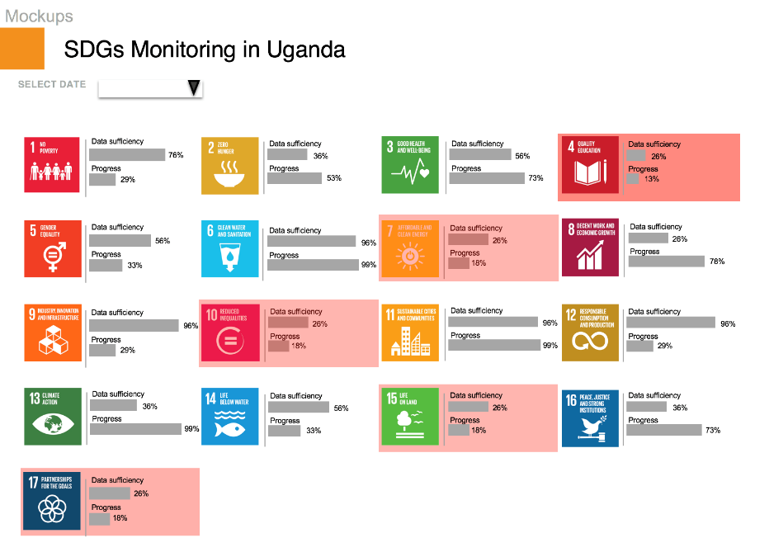
SDGs – Monitor SDGs
Short Description
The monitoring and reporting of the 169 indicators for the 17 SDGs requires solid data sources to monitor progress, inform policy and ensure accountability of all stakeholders. A subset of SDG indicators can be computed and tracked over time, using Call Detail Records (CDRs), which can be used as proxy for e.g. poverty, migration mobility, urban mobility, urban density, food spending
Persona: Chief Statistician (UBoS), Specialists in Coordination, Monitoring & Evaluation at OPM
Mission: Monitor and report progress towards sustainable development
Functionalities
Monitor progress for mobile data relevant SDGs indicators, such as: Proportion of individuals who own a mobile telephone, by sex and Proportion of individuals using the internet
Scalability Potential
Reaching the SDGs indicators is a major goal for development organizations and governments in 189 countries. If we proof success with a pilot in Uganda, we are certain that the vast majority of the developing countries can benefit from this approach of measuring indicators.
high

Slide 12
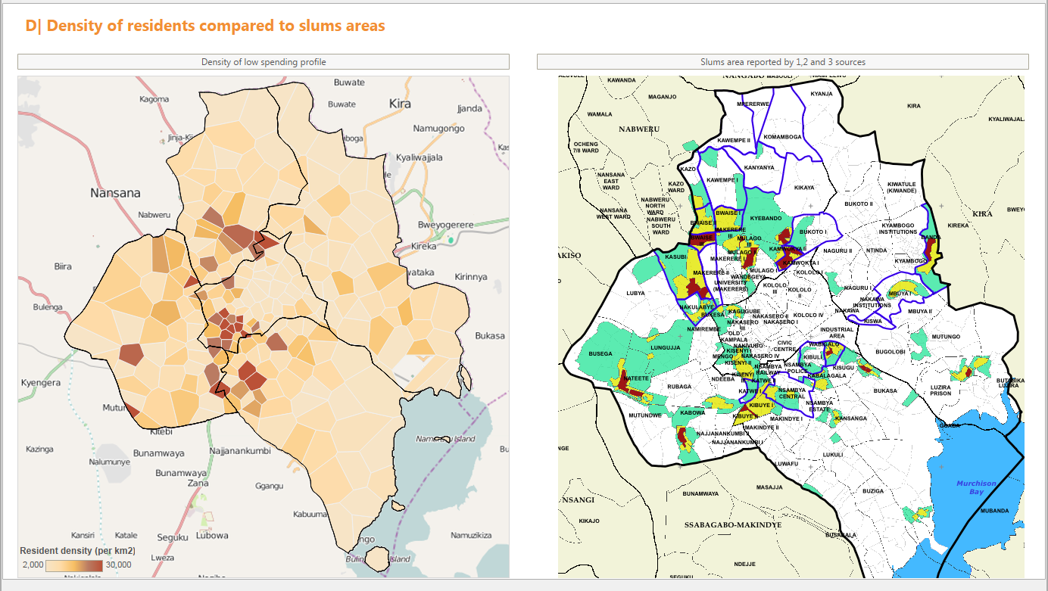
Poverty – Identify the poor neighborhoods

Slide 13
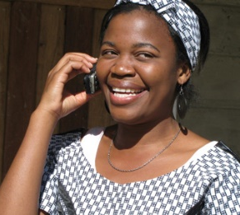
Gender – Identify female communities
Women are reliable and efficient users of microcredit loans, but how do you target them to increase financial inclusion?
We can identify women through their phone usage patterns.
Data
Airtel Uganda (39% women): CDRs, Top-ups + CRM data for the whole customer base
Dataset A (28% women): outgoing CDRs, Top-ups + CRM data for ca 160 000 users
Dataset B (42% women): CDRs, TOP-UPS + CRM for ca 160 000 users
Methodology
Over 150 features summarizing usage patterns, social network, mobility and top-ups
Trained random forests and support vector machines based on a labeled training sample
Results
3 key variables determining female gender: call duration, number of outgoing calls and number of contacts for incoming calls
Predicted gender accuracy of 70-75% and option to better target one gender group
Lowering the coverage increases the accuracy: for dataset A we are 90% sure of the gender for 30% of our sample

Slide 14
What should be done?

Slide 15
Governance – We need to have key elements in place
Key building blocks
A legal and regulatory framework
Data access from telecom operators
Leadership of the NSO (or other depending on the skills and willingness)
Use cases and end-users
Agreement from the regulator to pursue research
Invest in key structuring assets for the ecosystem
Develop governance and skills at NSOs

Slide 16
Data – We will need to go beyond telecom data
1
2
3
Telecom Analytics
for social impact
Analytics
for social impact
ICT
for social impact
Developing applications mainly based on telecom data (mobile & fixed)
Platform covering essentially telecom data from multiple operators
Scope of work principally encompasses mobility and consumption patterns
Applications based on telecom data but also on new data sources (e.g. satellite, health records)
Platform covering multiple data sources, formats and standards
Scope of work encompasses poverty mapping, agriculture and additional health use-cases
Data and technology solutions and services for the Public Good (broad scope)
Scope of work encompasses data collection, hardware installation and goes beyond the development of applications

Slide 17
Investments – Focus on key elements of the value chain
Key structuring element
<
<
Training tools and capacity building within end-users
<
Data-for-Good@RIA has been developing tools across all levels
Visualization tools and integration / implementation within end-users systems
<
Advanced algorithms
<
Platform of aggregates and First layer of aggregations, including standard aggregations
<
Data platform, including connectors and data checkers to standardize formats and ensure data quality
<
<
Telecom data, including CDRs, recharges, mobile money logs, mobile internet logs, network data such as BTS and utilization of the network
Third parties data sources, including satellite data, public health data, survey data, national statistics

Slide 18
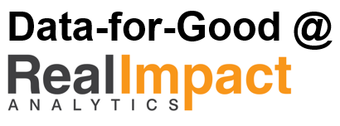
Start with a use case – Example of disaster prevention
Participants
What are we looking for?
Develop a proactive data system to accelerate reactions after natural disaster
Nethope will provide data from its NGOs
D4G@RIA will provide analytical capabilities
Tableau Foundation will provide visualization software
UW will provide framework and legal / regulatory approach
WEF will provide visibility
Need access to telecom data
Need leadership probably from NSO

Slide 20
We observe 5 possible business models
Business models with highest potential for scale-up and requiring initial external funding
Description and key characteristics
Long term view
Examples of stakeholders
In-house production of statistics
Telecom operators develop their own algorithms and use their own data to compute key aggregates
These aggregates are “sold” and eventually integrated into tools for end-users
Commercialization of data from the telecom operators
Limitation will come from the lack of capacity to integrate other external data sources and need to understand each end-user proper dynamics
Orange, Telefonica, Proximus
Send data to end-users
Telecom operators send data to end-users.
The end-users then develop their own algorithms and tools
Difficult to scale up as risks are too high
Ad-hoc analyses in case of natural disaster, research projects (e.g. Orange with D4D)
Trusted third party
Private or public party hosting individual data
Private or public party hosting aggregated data
Need to invest in setting up the governance, e.g. standard data format, access
Difficult to scale up for hosting individual data due to risk
Allow broad access to aggregated data for research or commercial purposes
Ultimately, it is a platform offering aggregated data
Some players (e.g. RIA) go into that direction but very early stage
Remote access
Private company access telecom data and develop and install their algorithms within the operator systems
Allow broad access to aggregated data for research or commercial purposes
Ultimately, it is a platform offering aggregated data
RIA, Flowminder
Move algorithms
Develop publicly available algorithms and allow any stakeholder to connect them to their available data
Allow broad access to 1st layer algorithms
Ultimately, it is a platform of algorithms
OPAL, e.g. Orange, universities/research insitutes

Slide 21
What criteria to use to set up business models?
Key elements and questions
Maximize the value generated for the society
How to foster scale and adoption by the end-users?
What are the elements of the value chain that are critical to create scale and maximize impact?
What are the business models structurally limiting the risks of under-developing the market?
What are the geographies and data sources allowing to reduce the risks?
Limit the risks
Build on and complement existing initiatives
What are the elements of the value chain which are already covered by existing funders?
What are the business models which are already running, avoiding to start from scratch?
Focus on key structuring elements
What are the market failures?
What are the elements of the value chain already covered by existing funders?
What are the elements of the value chain that could be building blocks to create scale and maximize value?

Slide 22
Covering a large part of the value chain but will need to focus
Data
Platforms
Apps
Data generation
Existing or guided data generation
Aggregation
Sourcing, 1st layer algorithms
Design
Single analyses and app design
Development
MVPs, Products
Implementation
From Deployment to Support
Corporations and individuals generating streams of data (e.g. telecom, satellite, health records, etc)
Apps to collect and generate data
Requires stable data environment governance or capacity to collect data and develop and run apps
Merging different data sources
Platforms transforming private data into workable aggregations
Requires strong academic knowledge (e.g. algorithmic) and connection to data generators
Running analyses and identifying actual correlations
Scoping and designing the apps
Develop more advanced algorithms
Requires strong industry dynamics understanding
Developing and shipping the applications to the end-users
Generally embeds the analytics transformations
Requires strong software development skills
Maintaining the application deployed for the end-users
Supporting and helping the end-users in the usage of the tools

