Slide 2
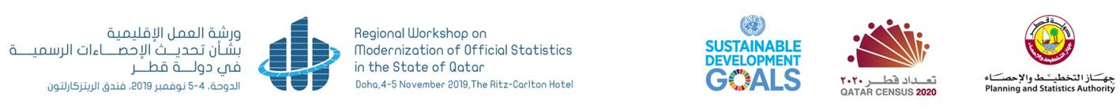
SCOPE OF MODERNIZATION OF OFFICIAL STATISTICS IN THE STATE OF QATAR
2017-2030
Ahmad Hussein, Ph.D.

Slide 3
SCOPE OF MODERNIZATION OF OFFICIAL STATISTICS
  Modernization of official statistics is about the re-design of statistical business processes along which data are collected, processed, disseminated and communicated
  A common framework is needed to identify and describe each individual process

Slide 4
SCOPE OF MODERNIZATION OF OFFICIAL STATISTICS (Cont.)
  Organizational Vision and Strategic Staff Engagement Strategies
  Improve the Efficiency of The Statistical Production Process
  Produce, Disseminate and Communicate Outputs that Better Meet User Needs
  Implementation of the Generic Statistical Business Process Model GSBPM V5.1

Slide 5
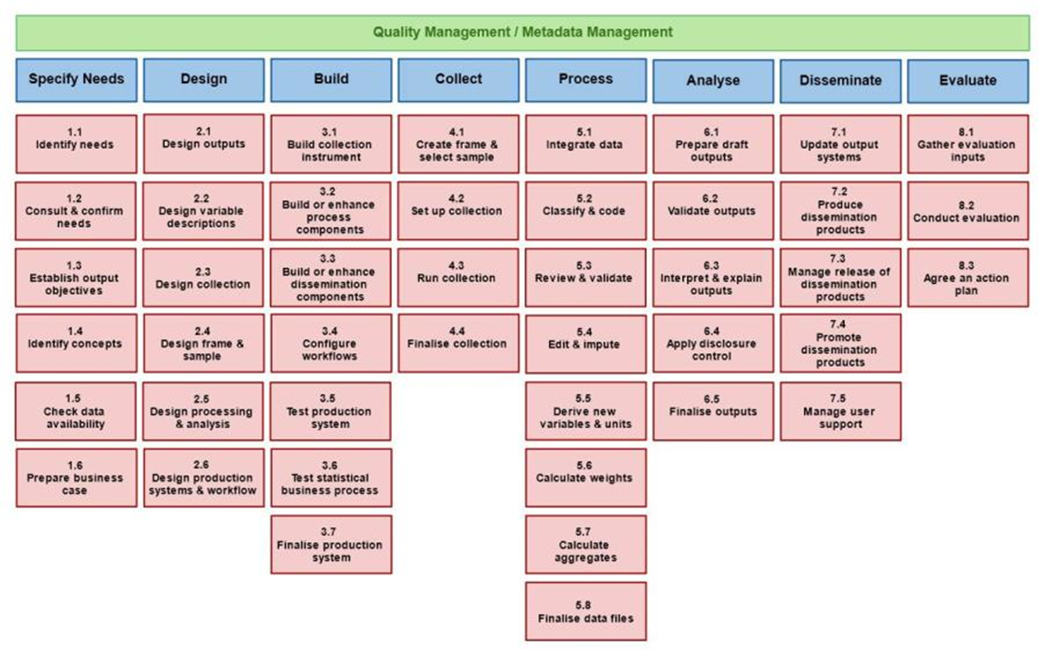
SCOPE OF MODERNIZATION OF OFFICIAL STATISTICS (Cont.)
GENERIC STATISTICAL BUSINESS PROCESS MODEL(GSBPM)
Source: UNECE

Slide 6
SCOPE OF MODERNIZATION OF OFFICIAL STATISTICS (Cont.)
Work With Line-ministries, Private Sector, Academia and Research Centers
Develop Frameworks and Share Information, Tools and Methods
Modernize Data Collection Infrastructure
Register – Based
Statistics
Innovative Survey Design
Development of Capabilities and Management
Innovation in Technology and Methods Driving Opportunities for Modernization
Integrating Geospatial Information and Statistics

Slide 7
SCOPE OF MODERNIZATION OF OFFICIAL STATISTICS (Cont.)
Innovation and
R & D Statistics
  Develop a Statistical Training Framework
Using Big Data in Official
Statistics
Statistical law and governance
Data Quality Framework

Slide 8
DATA QUALITY FRAMEWORK
SCOPE OF MODERNIZATION OF OFFICIAL STATISTICS (Cont.)
Define goals and objectives
Data Quality Strategy
Identify areas of opportunity
Assessment of Capabilities and Priorities
Implement improvements
Execute, Document and Take Action
Monitor changes and plan further improvements
Start a Cycle of Continuous Improvement

Slide 9
SCOPE OF MODERNIZATION OF OFFICIAL STATISTICS (Cont.)
MULTI-MODE POPULATION , HOUSING AND ESTABLISMENT CENSUS, 2020
Multi-mode Sources
Data Integration
Census
Results

Slide 10
BIG DATA ACTION PLAN AND ROADMAP
SCOPE OF MODERNIZATION OF OFFICIAL STATISTICS (Cont.)
Governance
Policy
Quality
Skills
Experience sharing
Legislation
IT
Infrastructures
Methods
Ethics / Communication
Big data sources
Pilots
Source: Eurostat

Slide 11




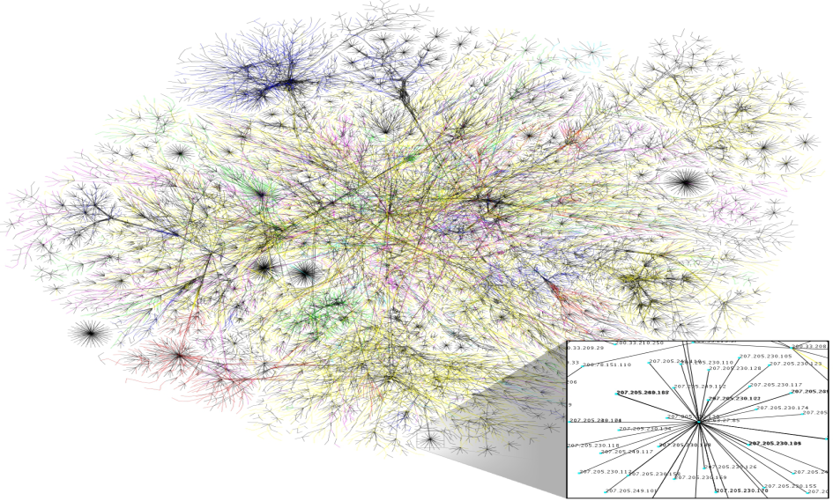



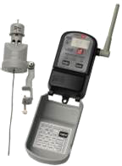





SCOPE OF MODERNIZATION OF OFFICIAL STATISTICS (Cont.)
DRIVERS OF BIG DATA
Source: Eurostat

Slide 12
SCOPE OF MODERNIZATION OF OFFICIAL STATISTICS (Cont.)
Towards a Framework for Measuring the Digital Economy

Slide 13
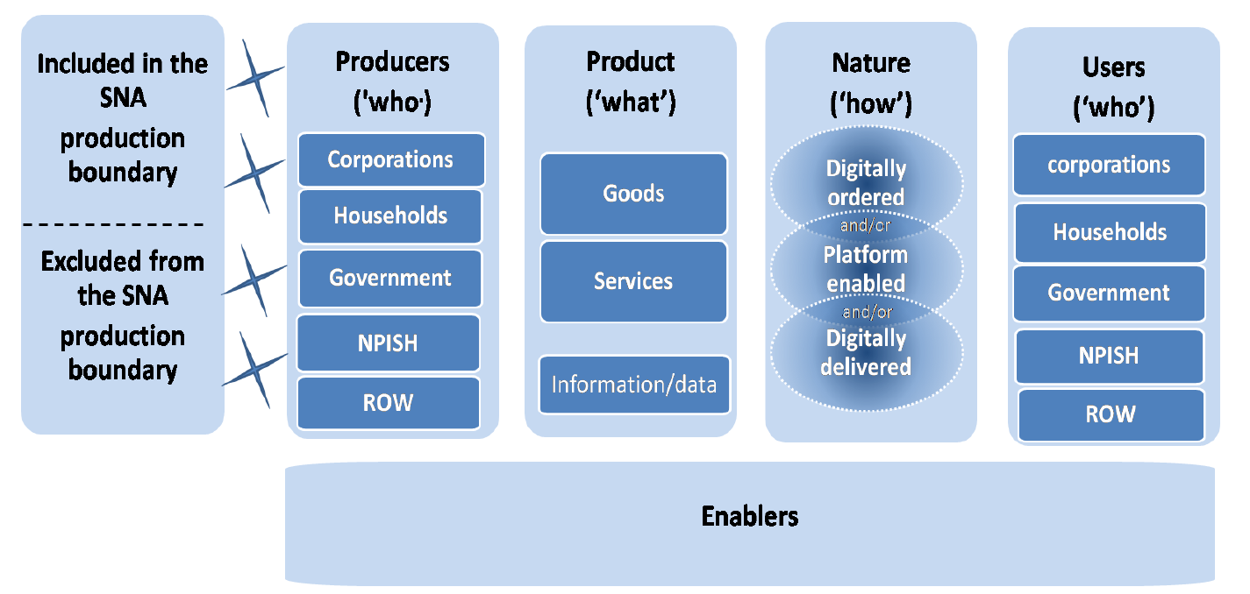
DRIVERS OF DIGITAL ECONOMY
SCOPE OF MODERNIZATION OF OFFICIAL STATISTICS (Cont.)

Slide 14
WHAT IS DATA SCIENCE ?
SCOPE OF MODERNIZATION OF OFFICIAL STATISTICS (Cont.)
Data science is a multi-disciplinary field that uses scientific methods, processes, algorithms and systems to extract knowledge and insights from structured and unstructured data

Slide 15
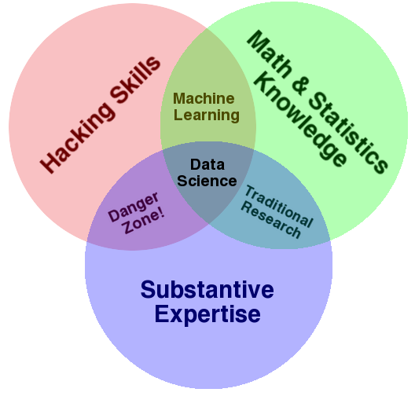
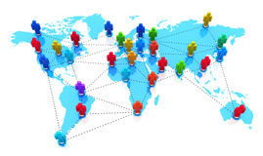
DATA SCIENTIST - COMPETENCES
SCOPE OF MODERNIZATION OF OFFICIAL STATISTICS (Cont.)
Specialized knowledge
Behavioural skills
Data Scientist
ICT skills
Data analytical skills
Methodologist skills

Slide 16
CONCLUTION
Old ways won’t open new doors
The world is changing profoundly
We have to adapt or become obsolete
Collaboration and joining forces are vital

Slide 17

Thank you
ahussein@psa.gov.qa

