Slide 2
CAPACITY DEVELOPMENT EFFORTS OF SESRIC IN THE MODERNISATION OF THE NSSs OF OIC COUNTRIES
ATILLA KARAMAN
Director, Statistics & Information Department, SESRIC

Slide 3
OUTLINE
Brief Introduction on SESRIC
Statistical Capacity Building Programme (StatCaB)
OIC Statistical Commission (OIC-StatCom)
Cooperation on Statistics with Regional and International Institutions

Slide 4
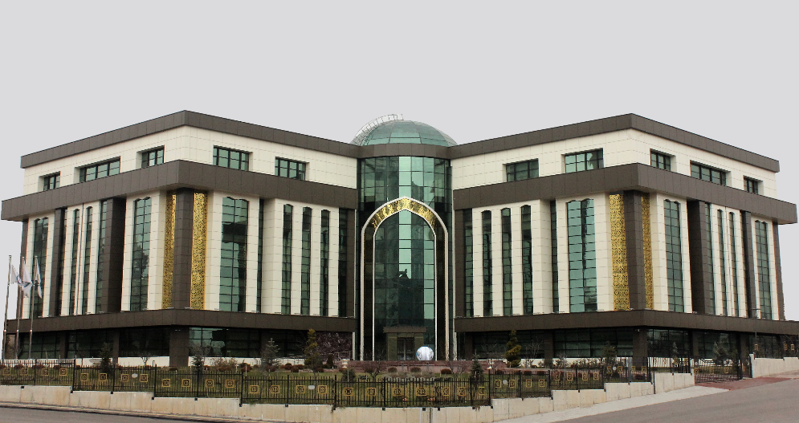
INTRODUCTION
Statistical, Economic and Social Research and Training Centre for Islamic Countries
Subsidiary Organ of the
Organisation of Islamic Cooperation (OIC)
Operating in Ankara,
Republic of Turkey
since June 1978.
Serving 57 Member States

Slide 5
INTRODUCTION
The basic mandate of SESRIC is threefold:
STATISTICS
Collate, process and disseminate socioeconomic statistics and information
Study and evaluate the economic and social developments towards generating proposals and policy recommendations
RESEARCH
TRAINING &TECHNICAL COOPERATION
Organise training programmes geared to the needs of the MCs as well as general objectives of the OIC

Slide 6
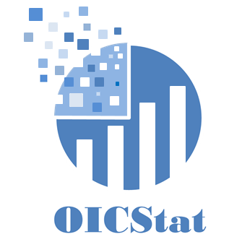
INTRODUCTION
Enhancing
Technical
Cooperation
Statistics
Statistical Cooperation with Regional and International Institutions

Slide 7
STATCAB PROGRAMME
Background
Reliable and quality data is a necessity for policy making and development planning
Varying levels of capacities of OIC countries for producing internationally-accepted statistical data
Potential for the transfer of knowledge and expertise among the NSOs and other constituents of the National Statistical Systems (NSSs)
Notes:
The accurate, timely, reliable and consistent statistical data is of utmost importance for policy making and strategy development in any country.
However, the member countries of Organisation of Islamic Cooperation (OIC) have varying levels of capacities for producing statistical data in accordance with the relevant internationally-accepted statistical standards.
Nevertheless, there is a huge potential for excahnge of know-how and best practices among the member countries despite the various levels of capacities

Slide 8
STATCAB PROGRAMME
Objectives
Strengthen statistical capacity development with an aim at producing better national statistics for better policies and strategies
Enhance the technical and human resources capacities of the NSOs and other constituents of NSSs
Improve linkages and partnerships among OIC countries based on a South-South Cooperation (SSC) spirit
Notes:
Against this background, SESRIC carries out an important role in strengthening and improving the National Statistical Systems (NSSs) in the OIC countries with a view to producing better national statistics and thus helping policy-makers introducing better national policies and strategies.
In this context, the Centre contributes significantly to enhancing the technical capacities and human resources of the National Statistical Offices (NSOs) of the member countries together with other constituents of National Statistical Systems (NSSs).
The other objective is to improve linkages and cooperation among OIC NSOs based on South-South Cooperation (SSC) spirit.

Slide 9
STATCAB PROGRAMME
History
Developed and initiated in 2007
Exemplary model for capacity development programmes of SESRIC
Flagship capacity building programme with around 380 activities organised so far
Notes:
With these objectives, the Centre carries out a flagship statistical skills development initiative titled “Statistical Capacity Building Programme (StatCaB)”.
The OIC StatCaB Programme was initiated in early 2007. In a shorter period of time, it has become the leading capacity development programme of the SESRIC which acted as an exemplary model for the establishment of other capacity building programmes.
To trigger the statistical cooperation linkages and thus contribute to the efforts of OIC countries in improving their statistical systems, the Centre collects information from the NSOs of OIC countries by conducting biennial questionnaires. The findings from these questionnaires enable the Centre to assess the needs and capacities of NSOs of OIC countries. Based on these corresponding needs and capacities, a matching is done among OIC countries to organise short term statistical courses, study visits, and technical missions. In its purest form, these statistical outreach activities facilitated among OIC countries through the OIC StatCaB Programme is built upon the South-South Cooperation (SSC) spirit. To increase the visibility of OIC StatCaB and the contributions of member countries into the Programme, the Centre regularly reports the implemented activities at not only the OIC level but also international levels.

Slide 10
OVERVIEW OF STATISTICAL ACTIVITIES
Since 2007, 381 Statistical Activities have been conducted by SESRIC
Notes:
Since 2007, the Centre has organized 381 statistical activities including 242 short-term statistics courses, 45 study visits, 20 technical missions, 65 international workshops and 8 Sessions of OIC-StatCom with the participation of more than 8,000 experts from the NSOs and constituents of the National Statistical Systems of OIC member countries.

Slide 11
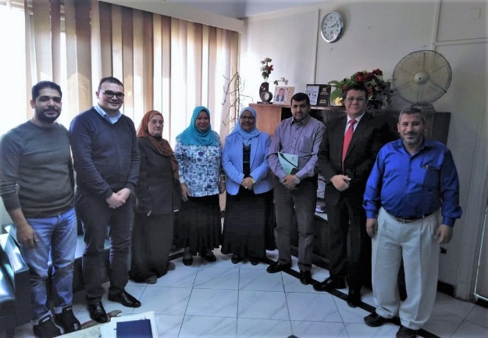
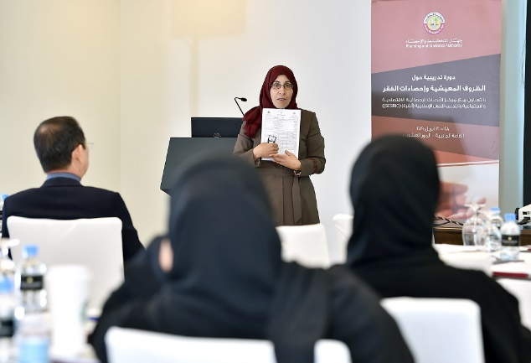
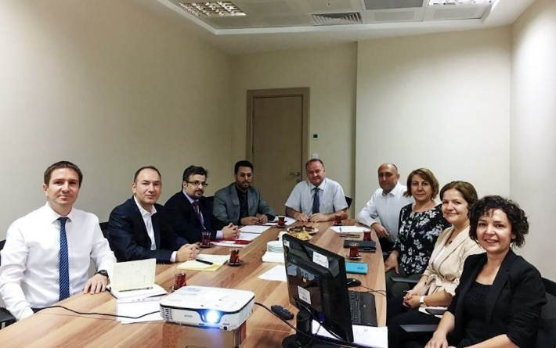
RECENT STATISTICAL ACTIVITIES
Study Visit on ‘Consumer Price Index’ to Egypt
16-18 April 2019
Beneficiary: DOS of Jordan
Statistics Course on ‘Living Conditions, Poverty and Cross-Cutting Social Issues’ in Qatar
28-30 April 2019
Provider: DOS of Jordan
Study Visit on ‘Education Statistics’ to Turkey
24-25 July 2019
Beneficiary: GASTAT of Saudi Arabia
Notes:
Samples of StatCaB Activities.
For more info please see http://www.oicstatcom.org/statcab.php.

Slide 12
STATCAB PROGRAMME
How does it work?
Biennial questionnaires circulated to identify the needs and capacities in three official languages of OIC (AR, EN and FR)
Matching among OIC countries to organise short term statistical courses, technical missions, and study visits
Prioritising OIC LDCs and supporting the trainers in their missions
Notes:
To trigger the statistical cooperation linkages and thus contribute to the efforts of OIC countries in improving their statistical systems, the Centre collects information from the NSOs of OIC countries by conducting biennial questionnaires.
The findings from these questionnaires enable the Centre to assess the needs and capacities of NSOs of OIC countries. Based on these corresponding needs and capacities, a matching is done among OIC countries to organise short term statistical courses, study visits, and technical missions. In its purest form, these statistical outreach activities facilitated among OIC countries through the OIC StatCaB Programme is built upon the South-South Cooperation (SSC) spirit. To increase the visibility of OIC StatCaB and the contributions of member countries into the Programme, the Centre regularly reports the implemented activities at not only the OIC level but also international levels.

Slide 13
STATCAB SURVEY RESPONSE FOR THE BIENNIUM 2020-2021
StatCaB Survey for the Biennium 2020-2021 was circulated in June 2019 to the NSOs, Ministries of Foreign Affairs and Embassies of OIC countries.
As of November 2019, Secretariat has received responses from 31 countries including:
Azerbaijan, Bangladesh, Benin, Brunei, Burkina Faso, Cote d’Ivoire, Djibouti, Egypt, Guinea, Indonesia, Iran, Iraq, Jordan, Kazakhstan, Kuwait, Malaysia, Maldives, Niger, Nigeria, Pakistan, Palestine, Qatar, Saudi Arabia, Senegal, Suriname, Tajikistan, Togo, Tunisia, Turkey, UAE and Uganda.

Slide 14
STATCAB SURVEY FOR BIENNIUM 2020-2021
PART C: SDG Indicators
PART B: Statistical Activities
PART D: Professional Skills
PART A: Institutional Information
Available at: http://www.oicstatcom.org/statcab.php
Notes:
To assess the needs and capacities, SESRIC collects information from the Constituents of the NSSs of Organisation of Islamic Cooperation (OIC) member countries by conducting biennial questionnaire. Last survey for the biennium 2020-2021 was circulated in January 2019.
StatCaB survey consists of:
PART A: Institutional Information (i.e., Contact Details of Institutions, Focal Point, Language Preference)
PART B: Statistical Activities (the list is based on Classification of Statistical Activities
(CSA Rev. 1 – Oct 2009)
PART C: Professional Skills (i.e., Effective Communication, Leadership & Personal Development in Official Statistics Setting, and Stakeholder Relations and Statistical Literacy)
Questionnaires are available in 3 official languages of OIC on: http://www.oicstatcom.org/statcab.php, consisting of 4 parts: institutional information, needs and capacities based on classification of statistical activities, needs and capacities based on SDG indicators, needs and capacities of professional skills.

Slide 15
CAPACITY DEVELOPMENT NEEDS ON SDGs
Notes:
From 31 Countries submitted survey, 4 countries namely Indonesia, Senegal, Togo, and Tunisia have not filled the needs and capacities on SDGs. We have resent back the survey to them for the completion of the StatCaB survey.

Slide 16
ASSSESMENT & MATCHING
Matching based on the corresponding needs and capacities in accordance with the priorities of the respondents
Short term statistics courses, technical missions, and study visits
Balance in geographical distribution among the OIC regions
Notes:
Based on the corresponding needs and capacities, a matching is done among OIC countries for the organization of short term statistics courses, study visits, and technical missions.

Slide 17
ORGANISATION FLOW OF A STATCAB ACTIVITY
SESRIC
Provider Country
MATCHING
ToR
COMPETENT EXPERT
LOGISTICS
ACTIVITY
Beneficiary country provides Terms of Reference (ToR) for more specific objectives, expected course coverage and outcome.
SESRIC
Notes:
First, we match the Countries based on their needs and capacities provided in the questionnaires.
Contact Beneficiary Country to provide Terms of Reference (ToR)
The Terms of Reference (ToR) for more specific objectives, expected course coverage and outcome.
Contact Provider Country to provide competent expert
Organise logistical matters
Implementation of StatCaB Activity

Slide 18
BENEFITS & OPPORTUNITIES
Opportunities to transfer statistical knowledge among OIC countries
Contribution to the harmonisation of national statistics production processes with the international standards and norms
Increasing development cooperation and maintaining a constructive dialogue among the OIC countries
Presents a valuable, cost-effective, and results-oriented approach for developing capacities to produce statistics on SDGs
Notes:
Unlock opportunities to transfer knowledge among OIC member countries
Hence, contribute to the harmonisation of national statistics production processes with the international standards and norms.
increasing development cooperation and maintaining a constructive dialogue among the OIC countries.
presents a valuable, cost-effective approach for reaching SDGs.

Slide 19
OIC STATISTICAL COMMISSION (OIC-StatCom)
The only OIC cooperation platform on official statistics for exchanging experiences and best practices to develop statistical capacities
Participation by high level officials from NSOs and other constituents of NSSs of OIC countries
SESRIC and IsDB as ex-officio members of the OIC-StatCom Bureau
SESRIC also carries out the Secretariat role
So far, 8 Sessions have been held since 2011
http://www.oicstatcom.org/
Notes:
OICSTATCOM Sessions
1st: Istanbul, Turkey
2nd: Izmir, Turkey
3rd: Ankara, Turkey
4th: Ankara, Turkey
5th: Ankara, Turkey
6th: Konya, Turkey
7th: Ankara, Turkey

Slide 20
OIC STATISTICAL COMMISSION (OIC-StatCom)
The 8th Session held on 23-25 Oct. 2019 in Ankara covered the following themes:
Electronic Data Collection Technologies in Population Censuses
A Census of Agriculture for the 21st Century
Developing Statistics Systems on International Labour Migration
Notes:
MEMBERS OF THE BUREAU (2018-2019):
Chair: Malaysia
Vice Chairs: Turkey and Tunisia
Rapporteur: Palestine and Uganda
BOARD MEMBERS (1 April 2018 – 31 March 2021)
Afghanistan
Benin
Chad
Cote d’Ivoire
Malaysia
Palestine
Saudi Arabia
Tunisia
Turkey
OICSTATCOM Sessions
1st: Istanbul, Turkey
2nd: Izmir, Turkey
3rd: Ankara, Turkey
4th: Ankara, Turkey
5th: Ankara, Turkey
6th: Konya, Turkey
7th: Ankara, Turkey

Slide 21
COOPERATION WITH PARTNERS

Slide 22
MEMORANDUM OF UNDERSTANDING
AITRS
IFSB
Venue: Amman, Jordan
Date: 30 April 2018
Venue: Istanbul, Turkey
Date: 22 Nov 2018
to collaborate in carrying out activities conducive to help OIC member countries improve their statistical systems to collect, process and disseminate relevant, quality and timely data for evidence based policy making to achieve their national development goals and strive towards the Sustainable Development Goals.

Slide 23
THANK YOU
Statistical, Economic and Social Research and Training Centre for Islamic Countries
Website: www.sesric.org
Email: oicankara@sesric.org
Twitter: @sesric

